Slide 1
Principled Sampling for Anomaly Detection
Brendan Juba, Christopher Musco, Fan Long, Stelios Sidiroglou-Douskos, and Martin Rinard

Slide 2
Anomaly detection trade-off
Catch malicious/problematic inputs before they reach target application.
Do not filter too many benign inputs.

Slide 3
Detectors need to be tuned!
Benign Error Rate
Aggressiveness

Slide 4
Requires accurate error estimation
Shooting for very low error rates in practice: .01%
Cost of false positives is high
Benign Error Rate
Aggressiveness

Slide 5
Estimating error rate
Anomaly Detector
Pass
Reject
Estimated Error Rate:
(# falsely rejected inputs)/(# total inputs)

Slide 6
What’s needed from a test generator?
Test Case
Generator
Anomaly Detector
Reject
Pass

Slide 7
1) Massive output capability
“With 99% confidence, estimated error rate accurate to within .01%”
Need ≈ 1/εlog(1/δ) ≈ 46,000 samples
Standard Techniques – Hoeffding bounds, etc.

Slide 8
1) Massive output capability
Benign Error Rate
Aggressiveness

Slide 9
2) Samples from representative distribution
Typical vs. Testing
Typical Inputs
Testing Inputs
nfl.com
npr.org
nfl.com
npr.org
dblp.de
dblp.de
mit.edu
mit.edu
arxiv.org
reddit.com
espn.com
arxiv.org
reddit.com
espn.com
wikipedia.org
harvard.edu
news.google.com
patriots.com
wikipedia.org
harvard.edu
news.google.com
patriots.com
scholar.google.com
scholar.google.com

Slide 10
2) Samples from representative distribution
With ≈ 1/εlog(1/δ) samples :
“With 99% confidence , estimated error rate accurate to within .01% ”.
from distribution D
for inputs drawn from distribution D
Only meaningful for similar
distributions!

Slide 11
Meaningful statistical bounds
“With 99% confidence, our anomaly detector errs on <.01% of benign inputs drawn from distribution D”.
≈ “With 99% confidence, our anomaly detector errs on <.01% of benign inputs seen in practice”.

Slide 12
Easier said than done
Samples need to be:
Cheap to generate/collect.
Representative of typical input data.
Getting both speed and quality is tough.

Slide 13
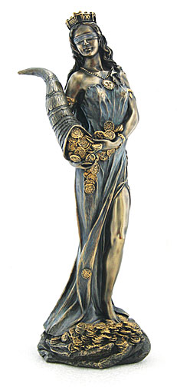
Possible for web data
Claim: We can quickly obtain test samples from a distribution representative of typical web inputs.
Fortuna: An implemented system to do so.

Slide 14
Random Search
Web Data: Images, JavaScript files, music files, etc.
mit.edu
reddit.com
npr.org
christophermusco.com
harvard.edu
patriots.com
news.google.com
wikipedia.org
dblp.de
nfl.com
scholar.google.com
espn.com
arxiv.org

Slide 15
Not enough coverage
Typical vs. Testing
Typical Inputs
Testing Inputs
nfl.com
npr.org
nfl.com
npr.org
dblp.de
dblp.de
mit.edu
mit.edu
arxiv.org
reddit.com
espn.com
arxiv.org
reddit.com
espn.com
wikipedia.org
harvard.edu
news.google.com
patriots.com
wikipedia.org
harvard.edu
news.google.com
patriots.com
scholar.google.com
scholar.google.com

Slide 16

Explicit Distribution
Can obtain a very large (although not quite complete) index of the web from public data sources like
seahawks.com
wikipedia.org
patriots.com
facebook.com
google.com
ask.com
cnn.com
arxiv.org
dblp.de
npr.org
mit.edu

Slide 17
Uniform sampling not sufficient
Typical vs. Testing
Typical Inputs
Testing Inputs
nfl.com
npr.org
nfl.com
npr.org
dblp.de
dblp.de
mit.edu
mit.edu
arxiv.org
reddit.com
espn.com
arxiv.org
reddit.com
espn.com
wikipedia.org
harvard.edu
news.google.com
patriots.com
wikipedia.org
harvard.edu
news.google.com
patriots.com
scholar.google.com
scholar.google.com

Slide 18
Can weight distribution
seahawks.com
wikipedia.org
patriots.com
facebook.com
google.com
ask.com
cnn.com
arxiv.org
dblp.de
npr.org
mit.edu

Slide 19
Computationally infeasible
Need to calculate, store, and share weights (based on traffic statistics, PageRank, etc.) for ~2 billion pages.
Weights will quickly become outdated.

Slide 20
Web Crawl
Web Data: Images, JavaScript files, music files, etc.
mit.edu
reddit.com
npr.org
christophermusco.com
harvard.edu
patriots.com
news.google.com
wikipedia.org
dblp.de
nfl.com
scholar.google.com
espn.com
arxiv.org

Slide 21
Locally biased
Typical vs. Testing
Typical Inputs
Testing Inputs
nfl.com
npr.org
nfl.com
npr.org
dblp.de
dblp.de
mit.edu
mit.edu
arxiv.org
reddit.com
espn.com
arxiv.org
reddit.com
espn.com
wikipedia.org
harvard.edu
news.google.com
patriots.com
wikipedia.org
harvard.edu
news.google.com
patriots.com
scholar.google.com
scholar.google.com

Slide 22
Potential Fix?
Combine with uniform distribution to randomly restart the crawl at different pages.

Slide 23

Fortuna based on PageRank

Slide 24
Definition of PageRank
PageRank is defined by a random surfer process
1) Start at random page 2) Move to random outgoing link 3) With small probability at each step (15%), jump to new random page

Slide 25
Weight = long run visit probability
Random surfer more likely to visit pages with more incoming links or links from highly ranked pages.

Slide 26
PageRank matches typical inputs
Typical vs. Testing
Typical Inputs
Testing Inputs
nfl.com
npr.org
nfl.com
npr.org
dblp.de
dblp.de
mit.edu
mit.edu
arxiv.org
reddit.com
espn.com
arxiv.org
reddit.com
espn.com
wikipedia.org
harvard.edu
news.google.com
patriots.com
wikipedia.org
harvard.edu
news.google.com
patriots.com
scholar.google.com
scholar.google.com

Slide 27
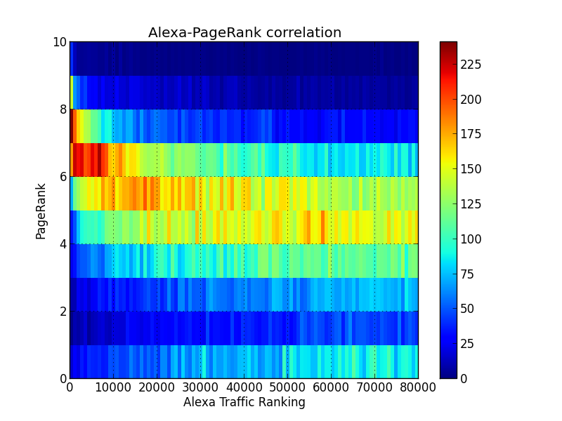
The case for PageRank
Widely used measure of page importance.
Well correlated with page traffic.
Stable over time.

Slide 28
Statistically meaningful guarantees
“With 99% confidence, our anomaly detector errs on <.01% of benign inputs drawn from the PageRank distribution”.
≈ “With 99% confidence, our anomaly detector errs on <.01% of benign inputs seen in practice”.

Slide 29
Sample without explicit construction
seahawks.com
wikipedia.org
patriots.com
facebook.com
google.com
ask.com
cnn.com
arxiv.org
dblp.de
npr.org
mit.edu

Slide 30
PageRank Markov Chain
Surfer process converges to a unique stationary distribution.
Run for long enough and take the page you land on as a sample. The distribution of this sample will be ~ PageRank.

Slide 31
Sample PageRank by a random walk
Immediately gives a valid sampling procedure:
Simulate random walk for n steps. Select the page you land on.
But:
Need a fairly large number of steps (≈ 100 – 200) to get an acceptably accurate sample

Slide 32
Truncating the PageRank walk
Observe Pattern for Movement:
Move = M (probability 85%)
Jump = J (probability 15%)
M
M
M
M
M
M
M
J
JMMJMMMMMMJMMJMMMMMMMMMJMJ
J
M
J
JMMMM

Slide 33
Fortuna’s final algorithm
JMMMM
Flips 85% biased coin n times until a J comes up
Choose a random page and take (n-1) walk steps
Takes fewer than 7 steps on average!

Slide 34
Fortuna Implementation
Simple, parallelized Python (700 lines of code)
Random jumps implemented using a publically available index of Common Crawls URL collection (2.3 billion URLs)
def random_walk(url, walk_length, bias=0.15):
N = 0
while True:
try:
html_links,soup = get_html_links(url, url, log)
if (N >= walk_length):
return get_format_files(soup, url, opts.file_format, log)
url = random.choice(html_links)
except Exception as e:
log.exception("Caught Exception:%s" %type(e))
url = get_random_url_from_server()
N += 1
return []
10’s of thousands of samples in just a few hours.

Slide 35
Anomaly Detectors Tested
Sound Input Filter Generation for Integer Overflow Errors:
SIFT Detector: .011% error (0 errors overall)
Automatic Input Rectification:
SOAP Detector: 0.48% for PNG, 1.99% for JPEG
Detection and Analysis of Drive-by-download Attacks and Malicious JavaScript Code: JSAND Detector
Tight bounds with high confidence: can be reproduced over and over from different sample sets.

Slide 36
Additional benefits of Fortuna
Adaptable to local networks
Does not require any data besides a web index
PageRank naturally incorporates changes over time

Slide 37
For web data we obtain:
Samples need to be:
Cheap to generate/collect.
Representative of typical input data.
Getting both speed and quality is very possible.

Slide 38
Step towards rigorous testing
Typical Inputs
Testing Inputs
nfl.com
npr.org
nfl.com
npr.org
dblp.de
dblp.de
mit.edu
mit.edu
arxiv.org
reddit.com
espn.com
arxiv.org
reddit.com
espn.com
wikipedia.org
harvard.edu
news.google.com
patriots.com
wikipedia.org
harvard.edu
news.google.com
patriots.com
scholar.google.com
scholar.google.com
Thanks!
1/εlog(1/δ)

